Slide 1
An Overview of the Ray-Tracing Rendering Technique
2019 01 07

Slide 2
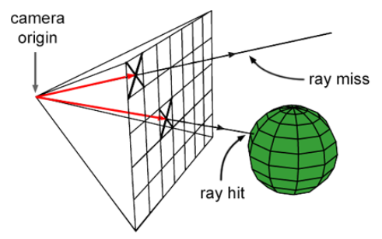
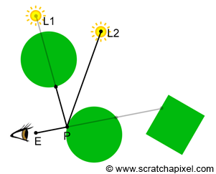
Ray-tracing
Visibility problem에 사용된다
Casting Rays:
cast a ray for each pixel in the image
2) Ray-Geometry Intersection:
test if a ray intersects any of the objects in the scene
(this requires to loop over all the objects for each cast ray).
3) Shading:
find out what the object "looks like" at the intersection point
between the ray and the object (if an intersection has occurred).

Slide 3
Whitted Ray-Tracing
Backward tracing
Reflection, refraction도 계산 가능
교점이 생기는 표면의 종류에 따라 다른 방식을 사용한다.
opaque, diffuse -> Phong model 사용해서 색 계산
Mirror like -> trace reflection ray
Transparent(glass, water) -> trace reflection, refraction ray

Slide 4
대략적인 소스코드 흐름
main
render(options, objects, 0);
for each pixel: castRay(orig, dir, objects, options);
if (trace(orig, dir, objects, tnear, index, uv, &hitObject))
if (objects[k]->intersect(orig, dir, tNearTriangle, indexTriangle, uvTriangle) && tNearTriangle < tNear) return true;
-> 색을 찾아 찍는다;
else return backgroundColor;

